Slide 1
POWER BI AND EXCEL DASHBOARD PORTFOLIO

Slide 2
WORKING WITH MICROSOFT POWER BI

Slide 3
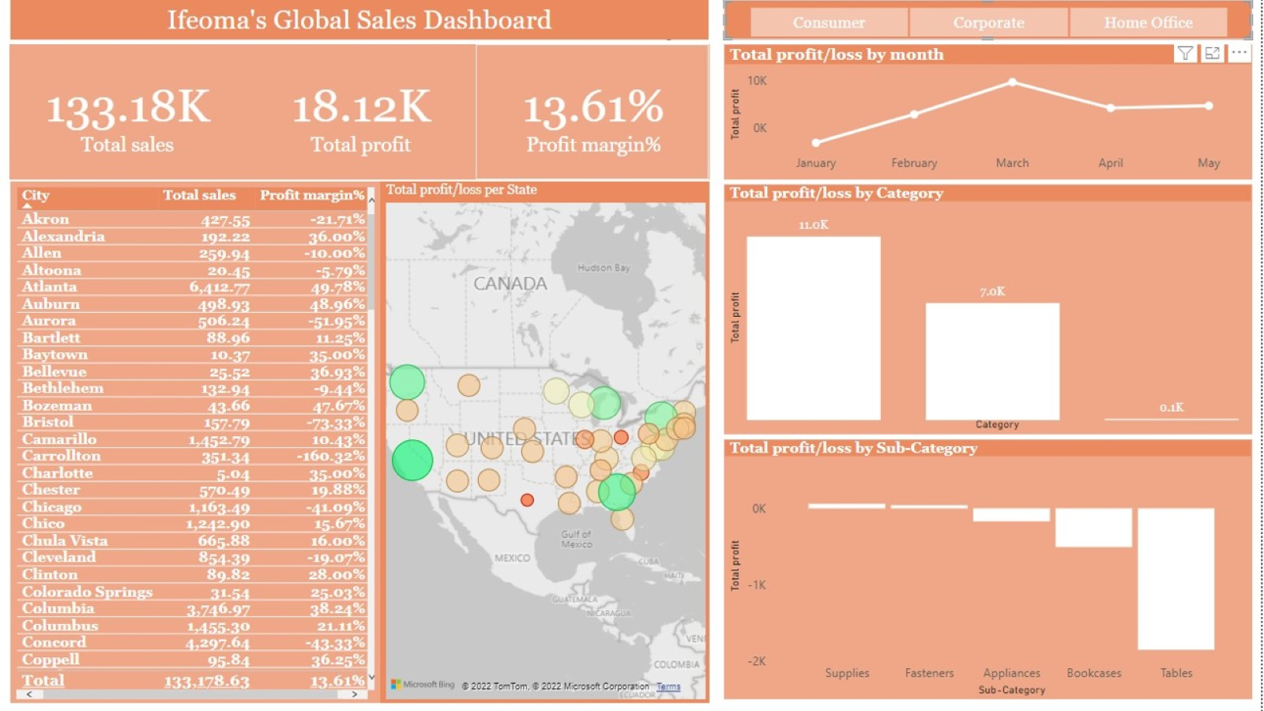

Slide 4
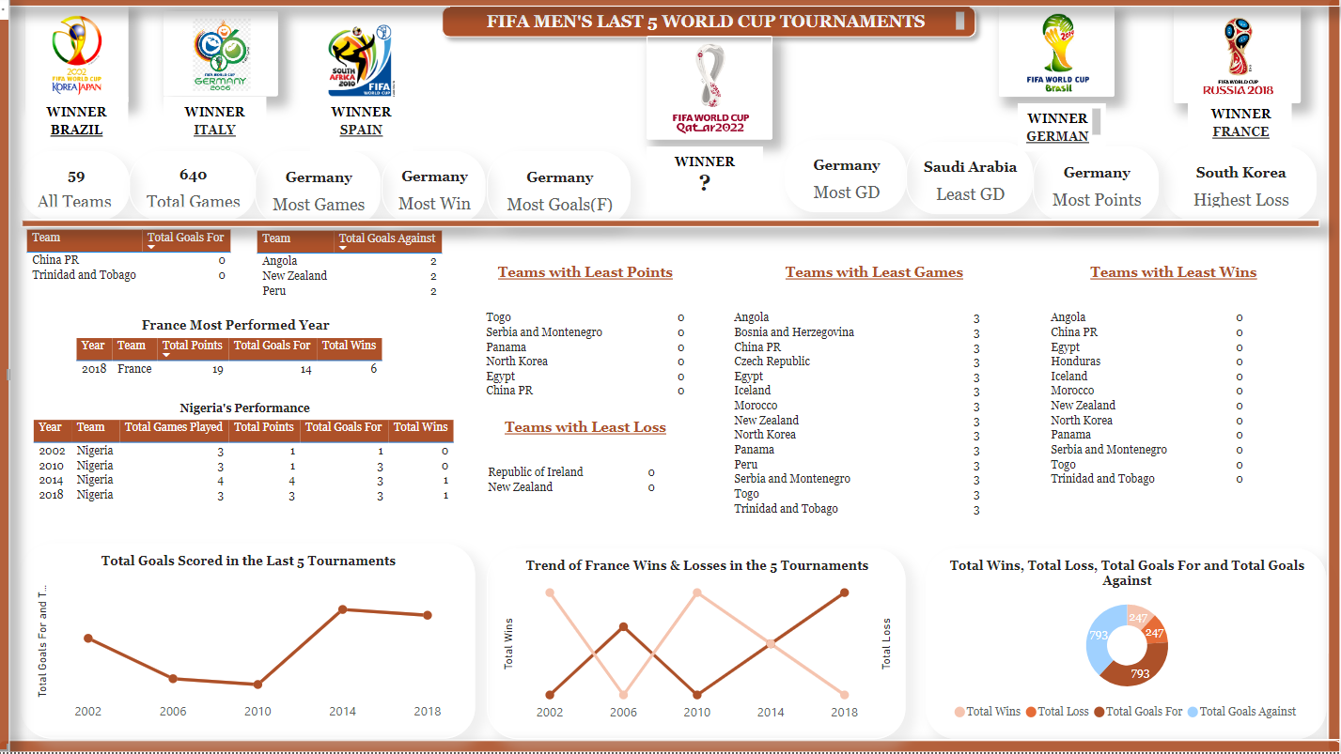

Slide 5
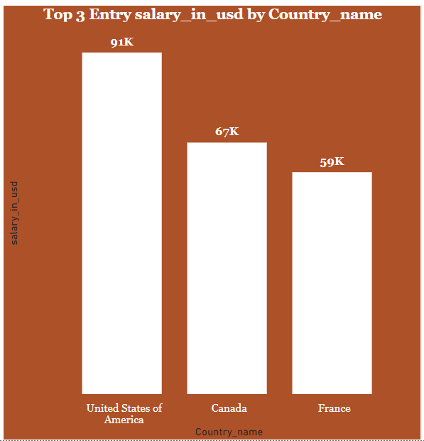
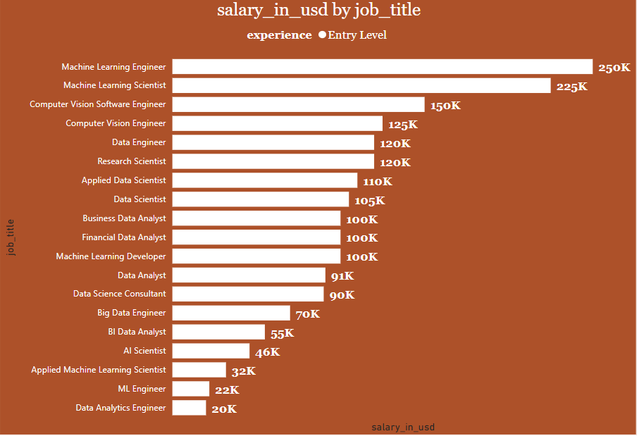
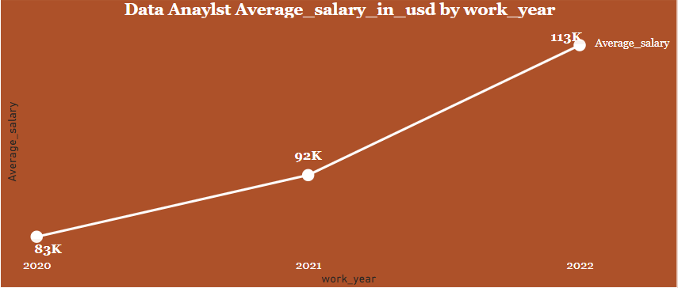
TREND OF DATA PROFESSIONALS ENTRY SALARY

Slide 6
WORKING WITH MICROSOFT EXCEL

Slide 7
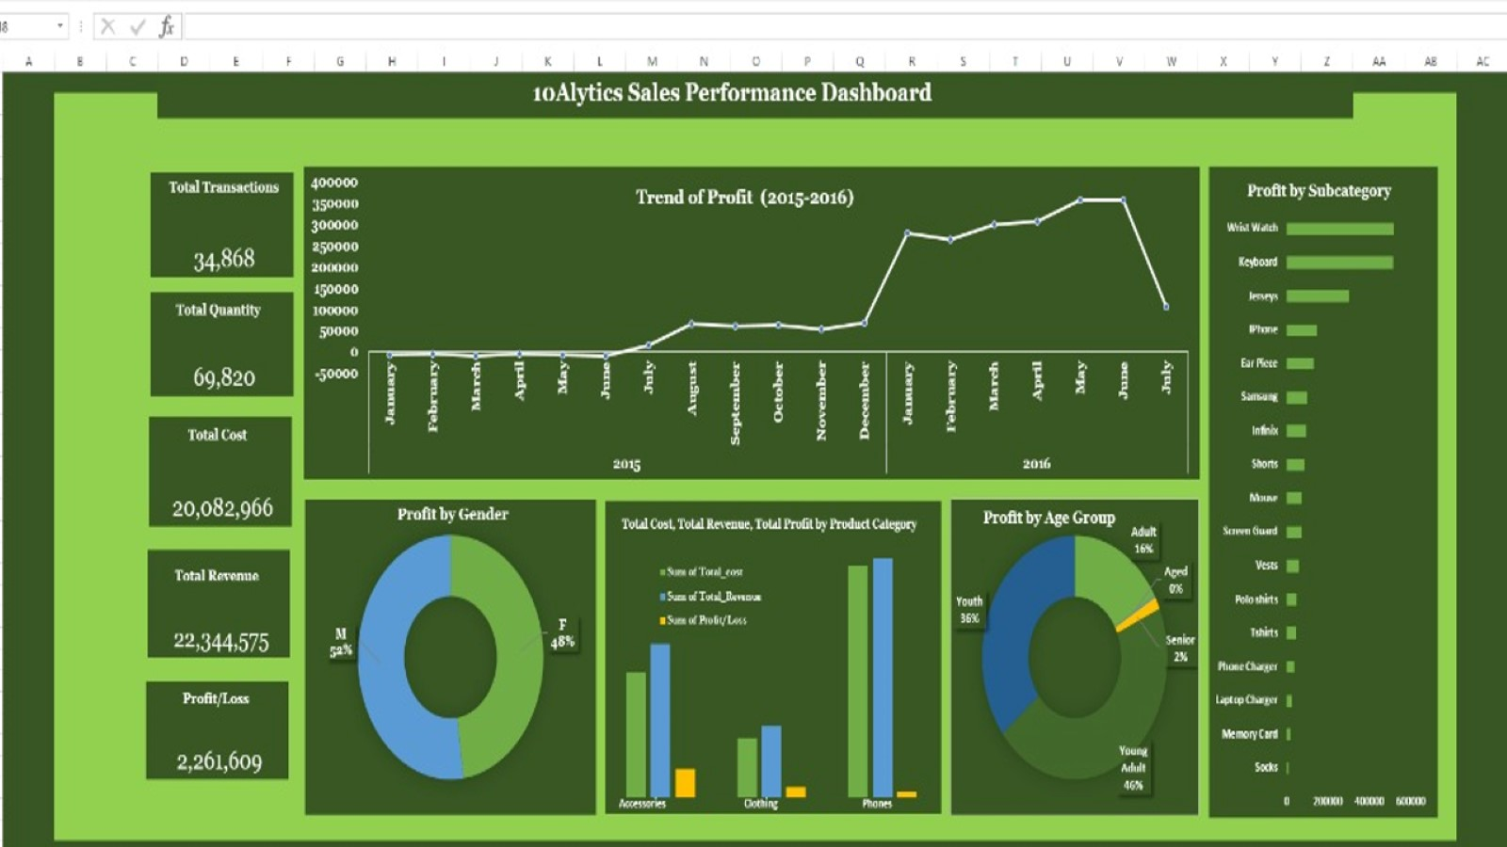

Slide 8
